Slide 1


Slide 2

INTRODUCTION ABOUT INNOVATION CLUB
https://www.youtube.com/watch?v=A1VXU4Zk_u4&t=30s

Slide 3
INNOVATION CLUB
The Innovation Club has been set up in Government, Non-Government, Grantee In Aid Colleges and Gram Vidhyapith, all over the State of Gujarat with the noble intention that even non-technical students, (studying in Arts, Commerce and Science Colleges) under which plentiful number of students will be encouraged for creative ideas and will be prepared for startups.
Innovation club is a concept to inspire and indulge non technical students to work on their ideas and convert them into startups. Innovation club is based on STEM pedagogy.
With help of innovation club students can generate their ideas and convert this ideas into real life products with tools provided by innovation club.

Slide 4

BASIC ELECTRONICS

Slide 5
YOUTUBE LINK FOR BASIC ELECTRONICS KIT
https://youtu.be/IeWHMeIQkxY

Slide 6
WHAT YOU WILL LEARN…
What is Electronics?
Main parameters of Electronics circuit: Voltage and Current
Circuit connections
Electronics components
IC

Slide 7
ELECTRONICS
Electronics : Electron + Mechanics
Electronics is the branch of science that deals with the study of flow and control of electrons (electricity).
Powered by a battery, they are designed to work under certain physics laws and principles.

Slide 8

ELECTRONICS DEVICES

Slide 9
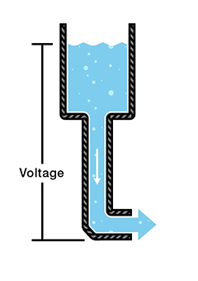
VOLTAGE
Voltage is an electrical potential difference, the difference in electric potential between two places.
Batteries are used to provide the voltage in the circuit
Denoted by V
Unit: Volt (V)

Slide 10
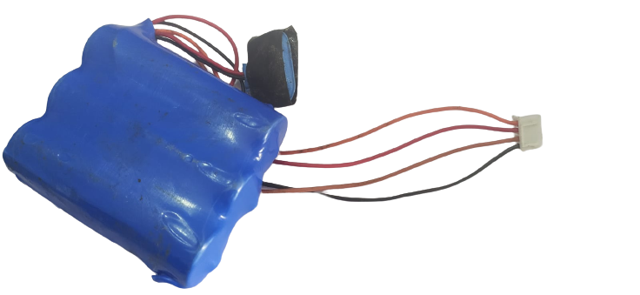
3 CELL BATTERY
12 V
8 V
4 V
GND

Slide 11
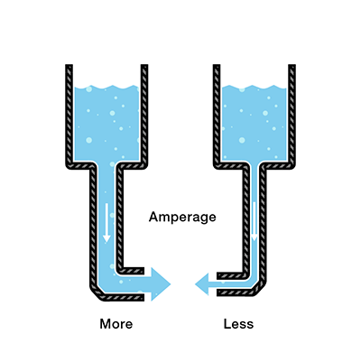
CURRENT
An electric current is a flow of electric charge.
In electric circuits this charge is often carried by moving electrons in a wire.
Denoted by I
Unit
Amperes (A)

Slide 12
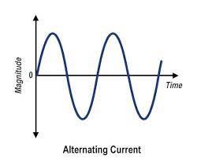
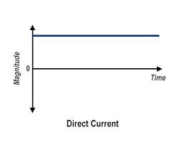
TYPE OF CURRENT
AC
DC

Slide 13
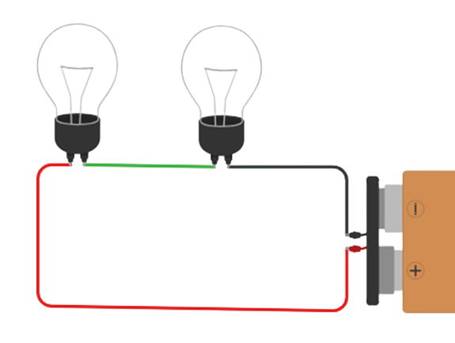
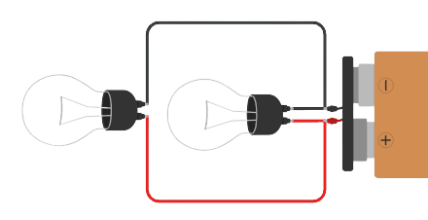
CIRCUIT CONNECTION
Series Connection
Parallel Connection
Two components are in series if they share a common node and if the same current flows through them.
components share two common nodes
Parallel components all have the same voltage drop across them

Slide 14
Electronics Components
Passive
Don’t need an external power source to function
Resistor, capacitor, inductor.
Active
Need an external power source to work
Diode, transistor, mosfet
Electromechanical
Carry out electrical operation by moving parts or by using electrical connections
Relay, Switches

Slide 15
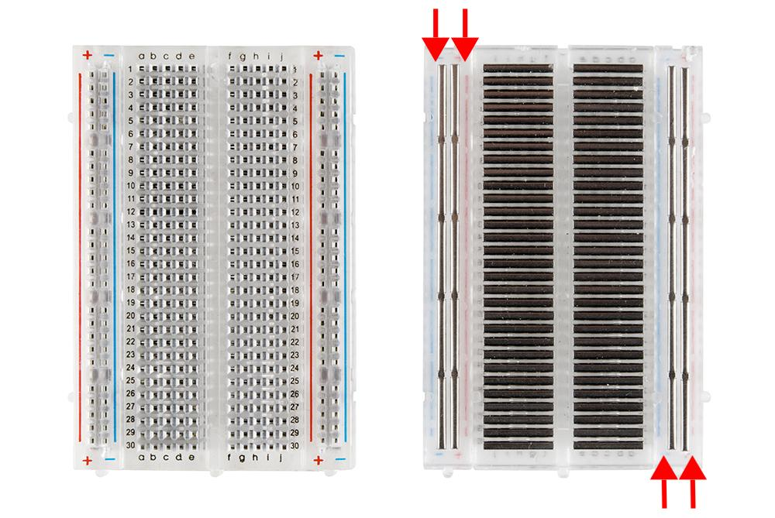
BREADBOARD
The purpose of the breadboard is to make quick electrical connections between components- like resistors, LEDs, capacitors, etc. - so that you can test your circuit before permanently soldering it together.
Internally connected
Internally connected

Slide 16
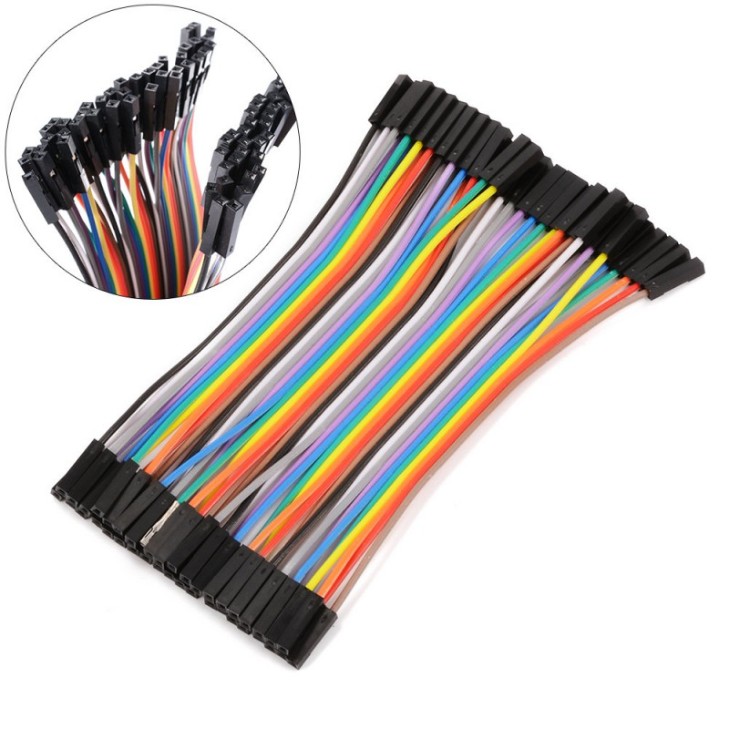
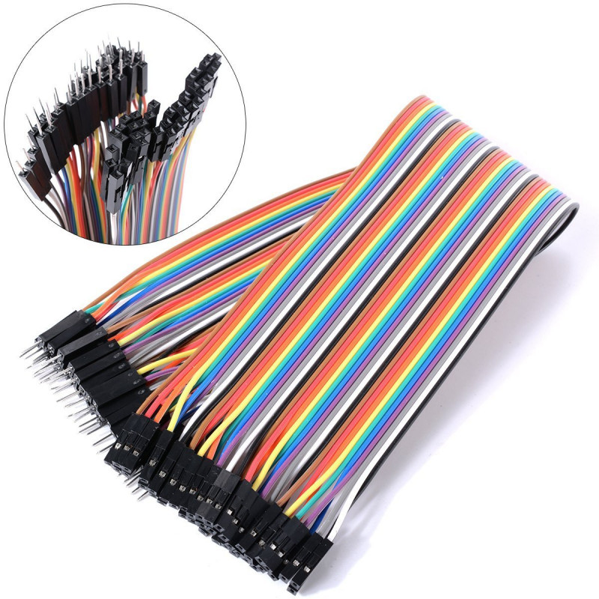
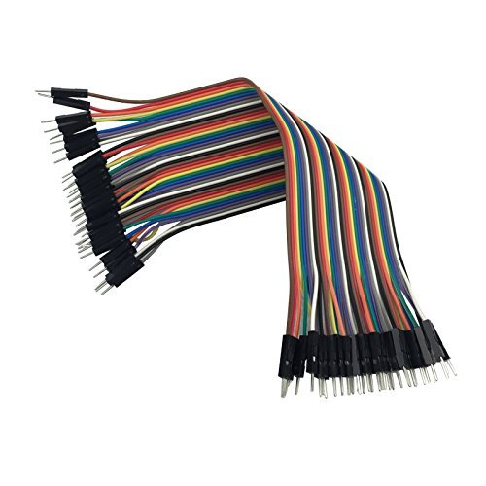
JUMPER WIRES
A jumper wire is an electric wire that connects remote electric circuits used for printed circuit boards.
Female - Female
Female - Male
Male - Male

Slide 17
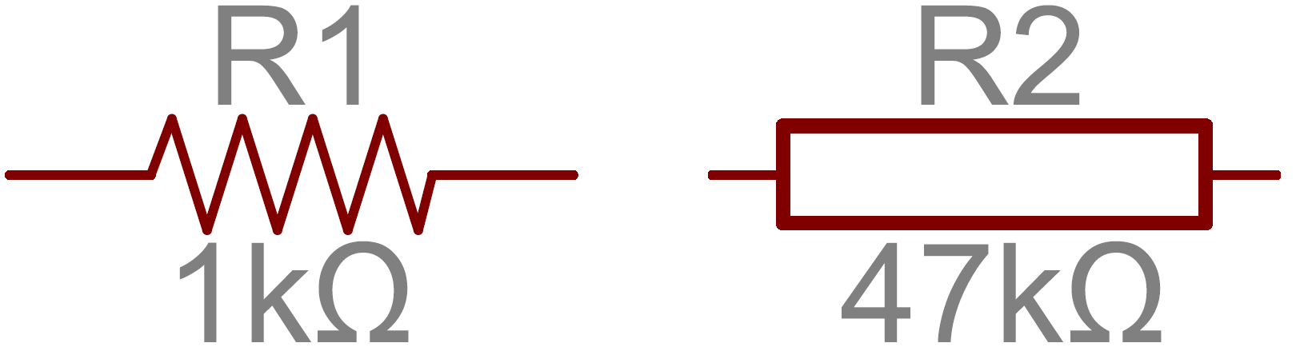
RESISTOR
A passive two-terminal electrical component that implements electrical resistance as a circuit element.
Used to reduce current flow, adjust signal levels, to divide voltages, bias active elements, and terminate transmission lines.
Unit: Ohm (Ω)
Symbol
Schematic Symbol
Resistor Value

Slide 18
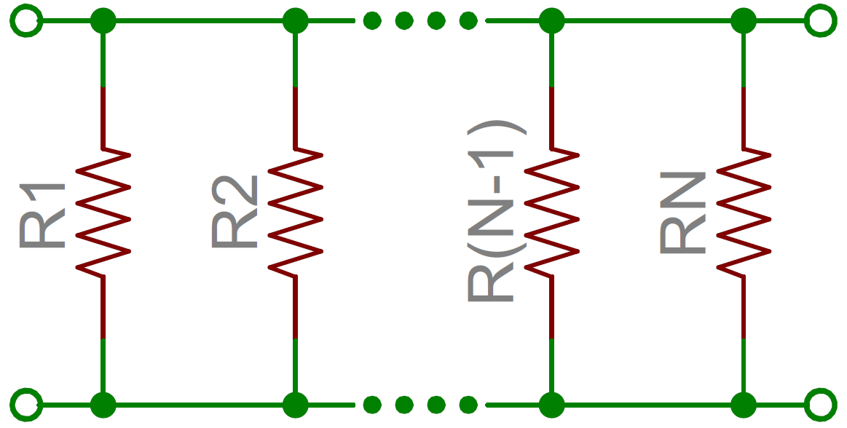
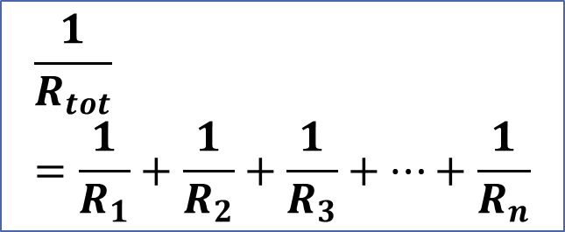
SERIES AND PARALLEL CONNECTION OF RESISTORS

Slide 19

OHM’S LAW
The voltage (V) across a resistor is proportional to the current (I), where the constant of proportionality is the resistance (R).

Slide 20
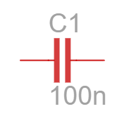
CAPACITOR
The effect of capacitor is known as Capacitance
It stores electrical energy in an electric field.
A capacitor consists of conductive parallel plates (two or more) which are electrically separated. They are generally separated by some good insulator, air or vacuum. This non insulating region is called as dielectric.
Unit: Farad (F)
Applications:
local energy storage
voltage spike suppression
complex signal filtering
Symbol
Schematic Symbol
Capacitance Value

Slide 21
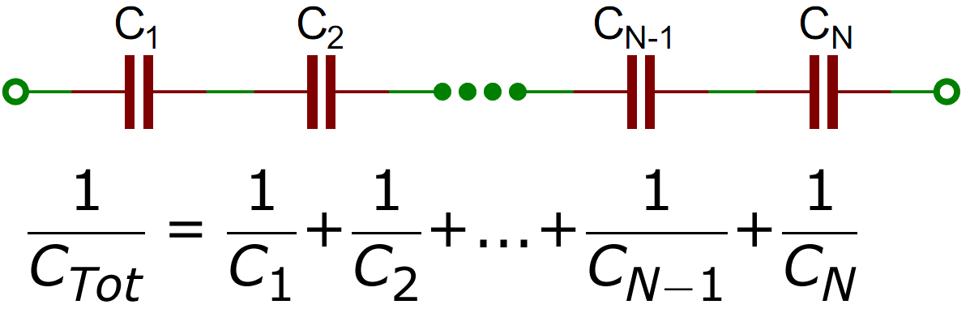
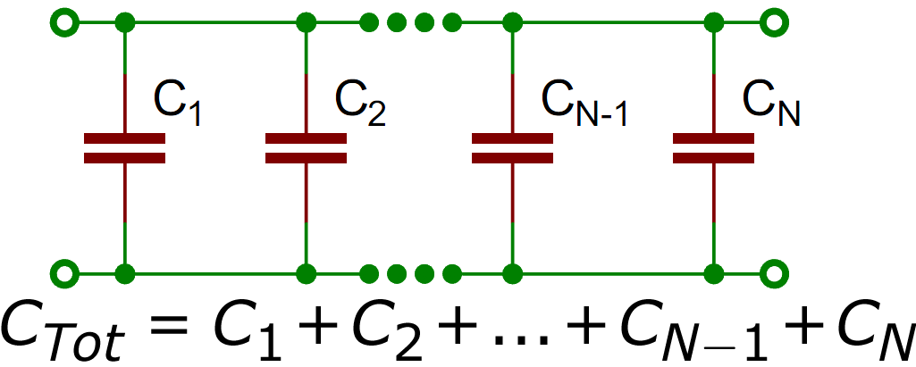
SERIES AND PARALLEL CONNECTION OF CAPACITORS

Slide 22
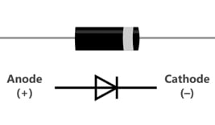
DIODE
It is a 2 lead semiconductor that acts as a one way gate to electron flow.
Diode allows current to pass in only one direction.
A pn-junction diode is formed by joining together n-type and p-type silicon.
The p-side is called anode and the n-side is called cathode.

Slide 23
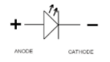
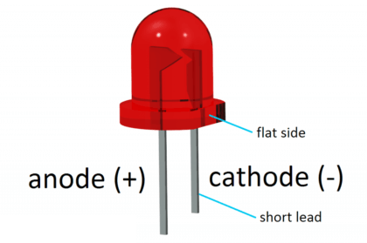
LED (LIGHT EMITTING DIODE)
It is a semiconductor light source that emits light when current flows through it.
Electrons in the semiconductor recombine with electron holes, releasing energy in the form of photons.

Slide 24
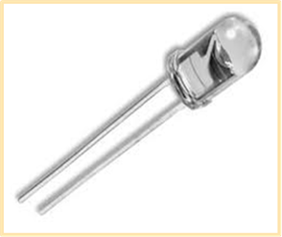
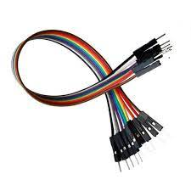
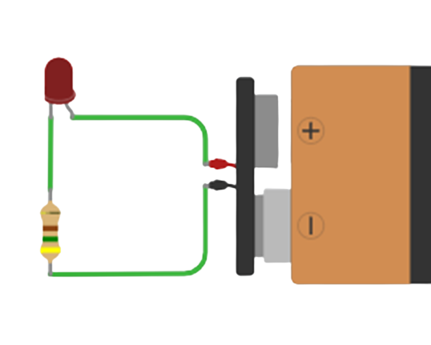
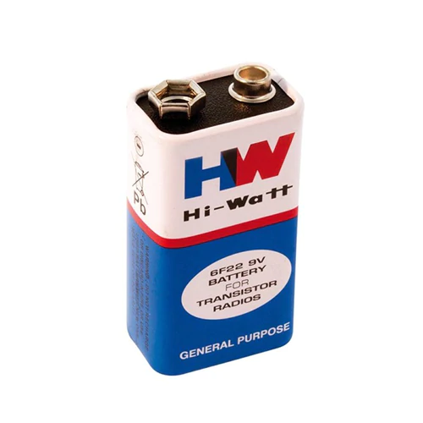
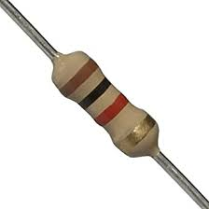
ACTIVITY 1: LED BLINK
LED
Jumper Wires
9V battery
Resistor

Slide 25
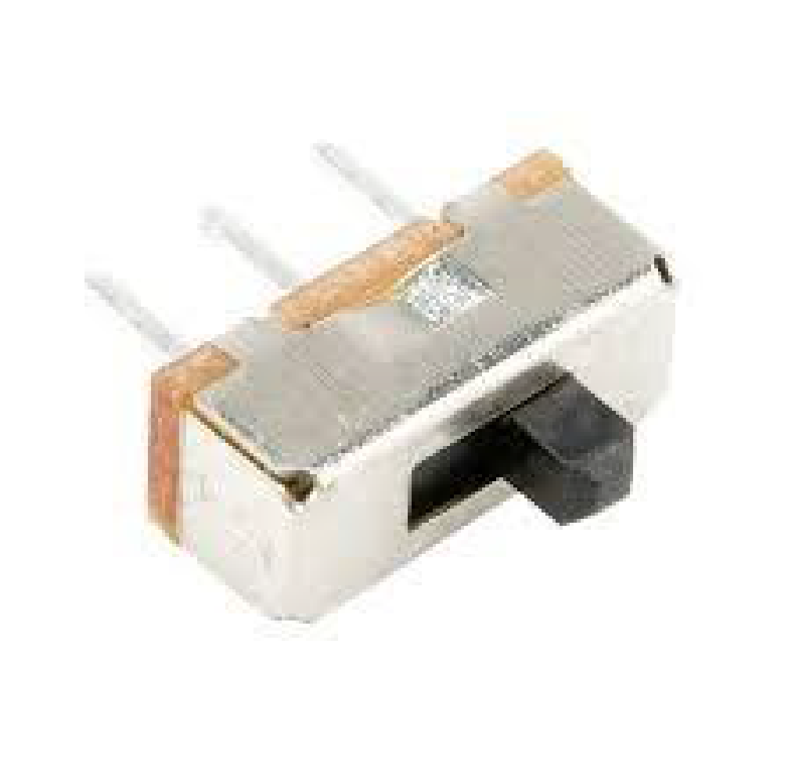
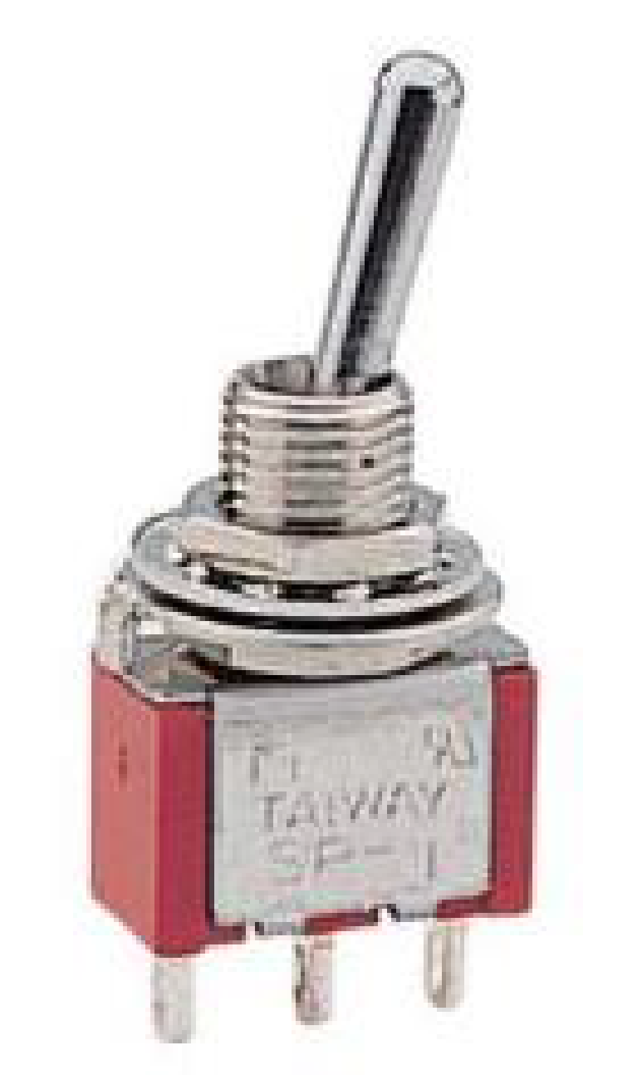
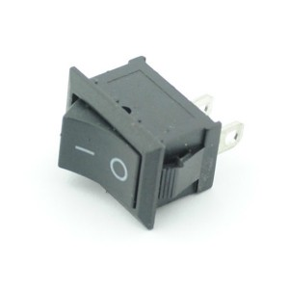
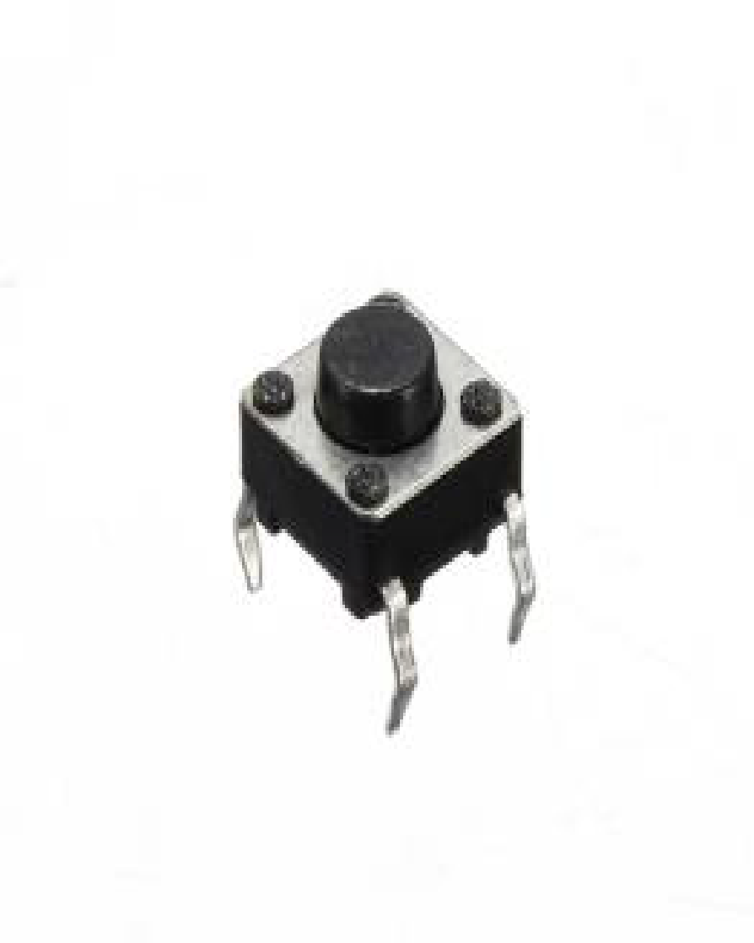
SWITCHES
A Switch is a device which is designed to interrupt the current flow in a circuit.
A switch can perform two functions, namely fully ON (by closing its contacts) or fully OFF (by opening its contacts).

Slide 26
TYPES OF SWITCHES
Mechanical
Activated physically, by moving, pressing, releasing, or touching its contacts.
Electronics
Generally called as Solid State switches
There are no physical moving parts and hence no physical contacts.
Transistors, MOSFETs, Relay, etc.

Slide 27
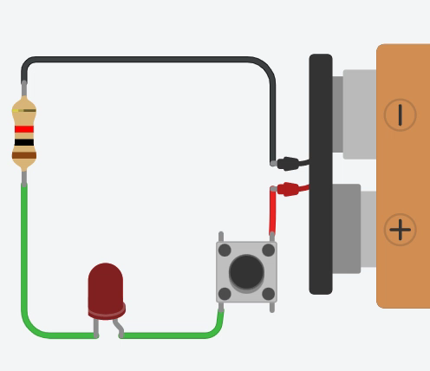
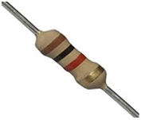
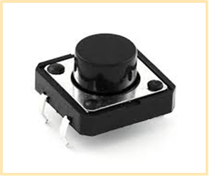
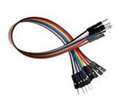
ACTIVITY 2: PUSH BUTTON INTERFACE
LED
Resistor
Push button
9V battery
Jumper Wires

Slide 28
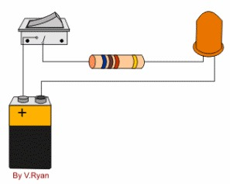
ACTIVITY 3: NORMAL SWITCH
LED
Resistor
Normal switch
9V battery
Jumper Wires

Slide 29
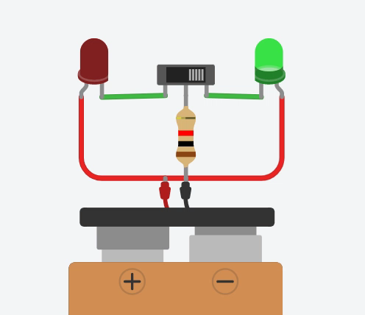

ACTIVITY 4: SLIDE SWITCH
LED x 2
Resistor
Slide Switch
9V battery
Jumper Wires

Slide 30
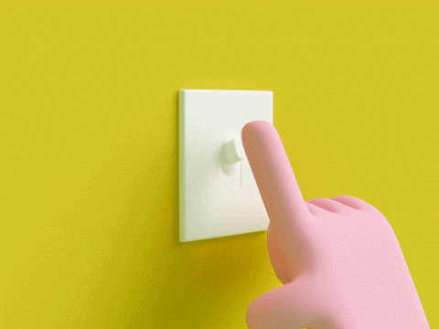
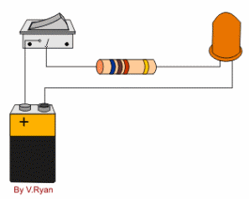
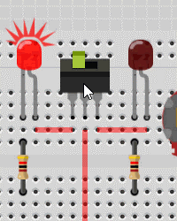
WORKING OF DIFFERENT SWITCHES
Push Button
Normal (SPST) Switch
Slide Switch

Slide 31
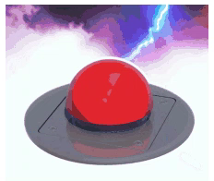
BUZZER
A buzzer or beeper is an audio signaling device.
Use of buzzer
Alarm devices
Timers
Train and confirmation of user input such as a mouse click or keystroke

Slide 32
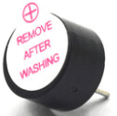
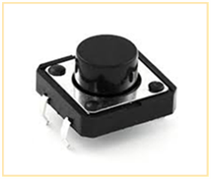
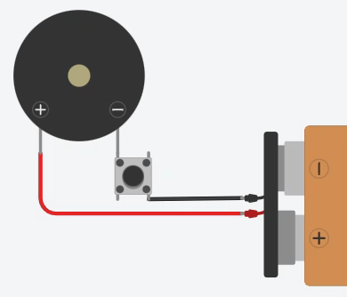
ACTIVITY 5: BUZZER
Buzzer
Push Button
9V battery
Jumper Wires

Slide 33
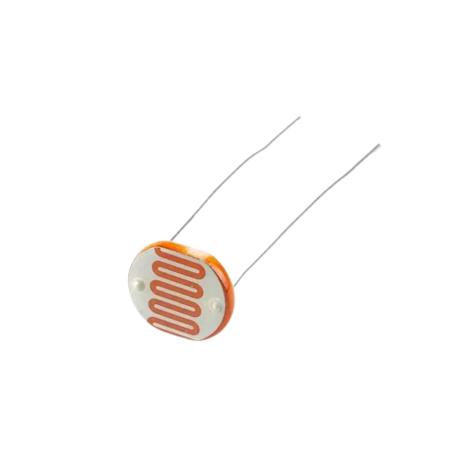
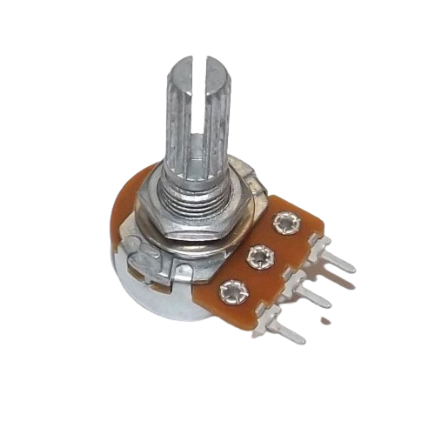
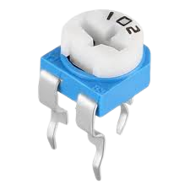
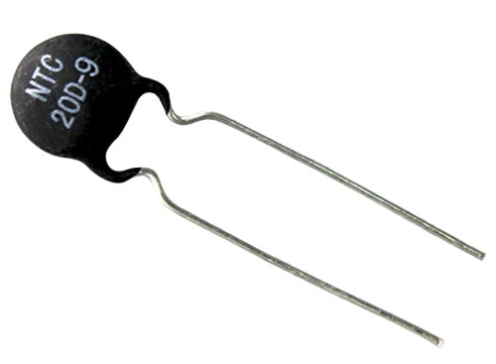
VARIABLE RESISTOR
A resistor of which the ohmic resistance value can be adjusted. Either mechanically (potentiometer, rheostat) or electronically (digital potentiometer).
Pots connect two resistors internally, in series, and adjust a center tap between them creating an adjustable voltage divider.
These variable resistors are often used for inputs, like volume knobs, which need to be adjustable.
Rotary
Potentiometer
Trimmer
Potentiometer
Photoresistor
Thermistor

Slide 34
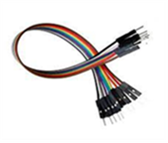
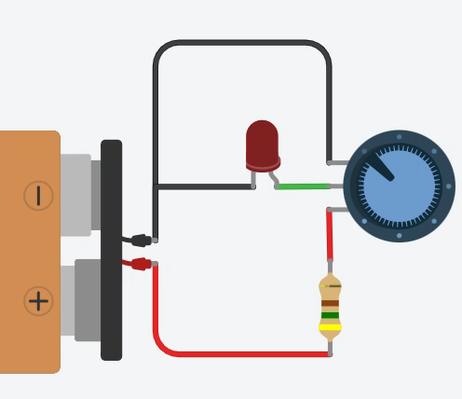
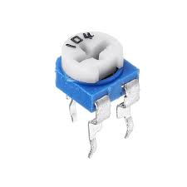
ACTIVITY 6: LED BRIGHTNESS CONTROL
LED
Jumper Wires
9V battery
Potentiometer

Slide 35
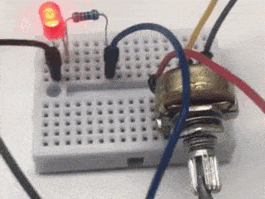
POTENTIOMETER INTERFACE
LED brightness is control by the rotary potentiometer.
When resistance of potentiometer is low, the LED brightness is high.
When resistance of potentiometer is high, the LED brightness is low.

Slide 36

TRANSISTOR
A Transistor is a three terminal semiconductor device that regulates current or voltage flow and acts as a switch or gate for signals.
A transistor is a semiconductor device used to amplify or switch electrical signals and power.
It is composed of semiconductor material, usually with at least three terminals for connection to an electronic circuit.

Slide 37


TYPE OF TRANSISTOR
N type transistor
P type Transistor

Slide 38

WORKING OF NPN AND PNP TRANSISTOR

Slide 39



ACTIVITY 7: TRANSISTOR AS A SWITCH
LED
Resistor x 2
Push button
9V battery
BC547 transistor
Jumper Wires

Slide 40
IC 555 TIMER
The operating range of this IC ranges from 4.5V -15V DC supply.
The functional parts of the 555 timer IC include:
SR flip-flop
Voltage divider
Two comparators
Inverter.
The main function of this IC is to generate an accurate timing pulse.
It’s applications
An oscillator
Pulse generation
Timer.

Slide 41

PINOUTS OF 555 TIMER IC
Connected to the positive power supply voltage.
Connect the IC to ground
Ground
Vcc
It works like a starter pistol to start the timer running
Trigger
Discharge
Monitor the voltage across the capacitor that's discharged by pin 7.
Output is digital in nature. It is either high or low.
Output
Threshold
Reset
Control
This pin can be used to restart the 555 timer's timing operation
This pin is simply connected to ground, usually through a 0.01 µF capacitor.

Slide 42
ACTIVITY 5: LED BLINK USING 555 TIMER
Description
Material List
555 timer IC is used to create time difference in various applications.
The Blinking LED circuit uses a 555 timer in astable mode, which generates a continuous output in the form of a square wave at output pin.
Output waveform will turn LED ON and OFF.
The duration of ON/ OFF depends on the time cycle of the square wave.
2 x 1kΩ resistors
100kΩ resistor
10uF capacitor
LED
555 IC
9V battery

Slide 43

DIAGRAM FOR LED BLINKING
1kΩ
1kΩ
10uF
100kΩ

Slide 44
MECHANICAL KIT

Slide 45
YOUTUBE LINK FOR MECHANICAL KIT
https://youtu.be/aoU6fK6cwBc

Slide 46

MULTIMETER
Used for measuring voltage, current and resistance and can check:
Battery voltages
Vehicle electrics and electronics
Continuity of cables and power cords
Home appliances and electronic devices
Fuses

Slide 47


CURRENT & VOLTAGE MEASUREMENT
Voltage measurement
Current measurement

Slide 48

RESISTANCE MEASUREMENT USING MULTIMETER

Slide 49


LED CHECK USING MULTIMETER
LED BLINK
DAMAGED LED

Slide 50

CONTINUITY CHECK

Slide 51


GLUE GUN AND GLUE STICK
Glue Gun
Glue stick

Slide 52
APPLICATION
For commercial or business
Household
hobby and craft applications
inexpensive glue guns and glue sticks are used for parts assembly, repair and connection of different materials.

Slide 53



USE OF GLUE GUN

Slide 54

SOLDERING KIT
Components in Soldering kit:
Soldering Iron
Soldering Stand
Soldering Wire
Flux
Wire Cutter
Desodering Wire

Slide 55



USE OF SOLDERING KIT
Solder the Wire
Soldering the components
Desoldering

Slide 56
GLIDER PLANE

Slide 57

PARTS IN GLIDER BOX
In Box:
Body
Lower wing
Upper wing
Horizontal tail
Wing connection buckle x 2
Data line

Slide 58
YOUTUBE LINK FOR ASSEMBLE THE GLIDER
https://www.youtube.com/watch?v=z8j6clEOkYI

Slide 59



ASSEMBLE THE GLIDER
1
2
3

Slide 60


ASSEMBLE THE GLIDER
4
5

Slide 61

CHARGE THROUGH THE USB

Slide 62

FLY THE GLIDER
Turn on the switch to power the glider
Press the power button
Throw the glider into the air when Motor starts.

Slide 63


QR CODES
Quiz form
Feedback form

Slide 64


SOCIAL MEDIA QR CODE

Slide 65
THANK YOU

